Slide 1
GPU Cost Estimation for Load Balancing in Parallel Ray Tracing
Biagio Cosenza*
Universität Innsbruck Austria
Carsten Dachsbacher
Karlsruhe Institute of Technology
Germany
Ugo Erra Università della Basilicata Italy

Slide 2
Outline
Motivation
Parallel Ray Tracing
Generating the Cost Map
Exploiting the Cost Map for Load Balancing
SAT Adaptive Tiling
SAT Sorting
Results

Slide 3
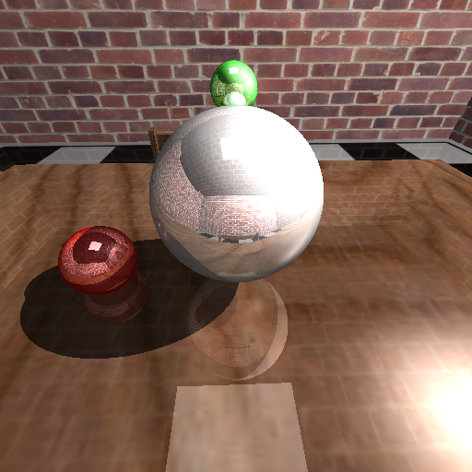
Ray Tracing Algorithms
Notes:
Simple form of RT
Components of the RT algorithm
Primary rays generation
Intersection algorithms
Acceleration data structure
Shading
Frame buffer

Slide 4
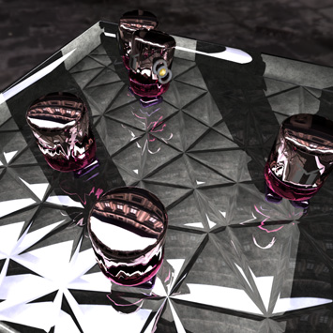
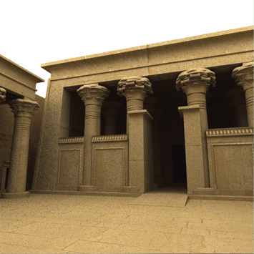
Ray Tracing Algorithms
Toasters, Whitted 8.4M primary rays
Kalabasha Temple, path tracing 134.2M primary rays
Notes:
Our goal is to handle very different (in quality and interactivity) scenarios. Ranging from a simple Whitted stle ray tracing to a Monte Carlo based.
Whitted is fast enough to rach interactive frame rate today.
MC techinques, instead, are slow – but photorealitic – phisically based

Slide 5
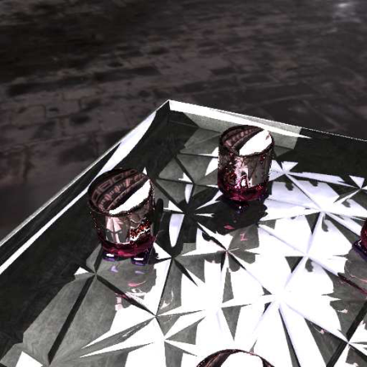
Motivation
Load balacing is the major challenge of parallel ray tracing on distributed memory system

Slide 6
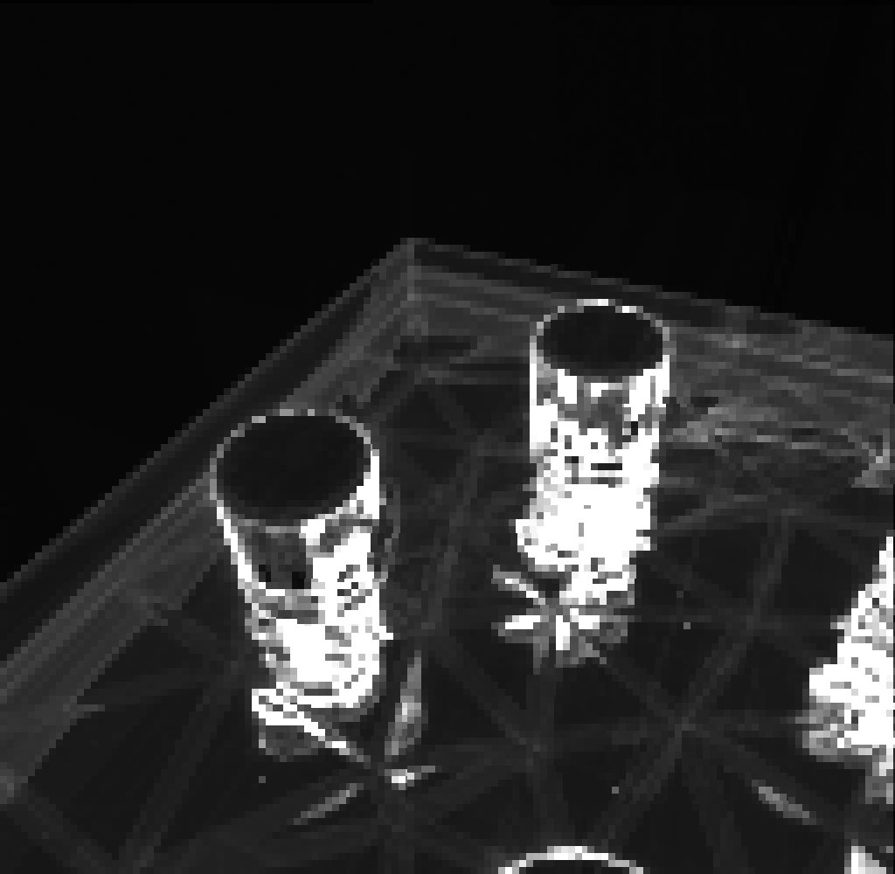
Motivation
Load balacing is the major challenge of parallel ray tracing on distributed memory system
Ray traced image
Cost map
Notes:
Wouldn't it be nice, if we had this cost map earlier? It would make load balancing much easier! let's look at the cost map... hey, we can observe that it is more costly in concave regions, depending on the material, ... many aspects that we could easily figure out with image-space information!

Slide 7
Motivation
Ray traced image
Cost map
Can we generate a cost map before rendering?
Can we exploit it to improve load balancing?
Notes:
Wouldn't it be nice, if we had this cost map earlier? It would make load balancing much easier! let's look at the cost map... hey, we can observe that it is more costly in concave regions, depending on the material, ... many aspects that we could easily figure out with image-space information!

Slide 8
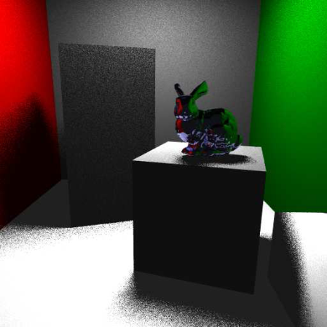
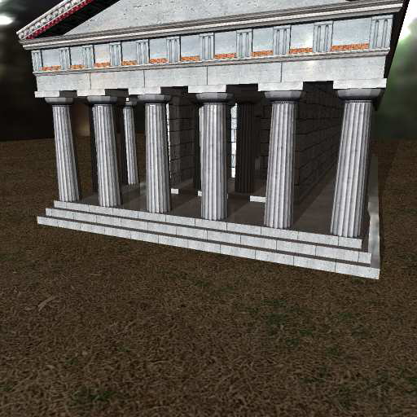
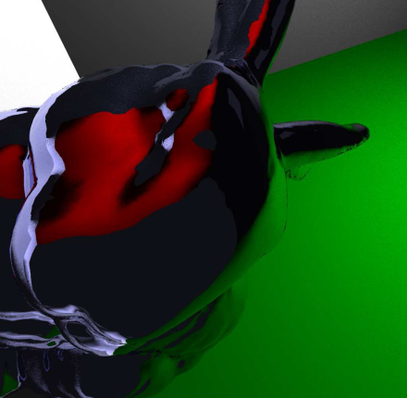
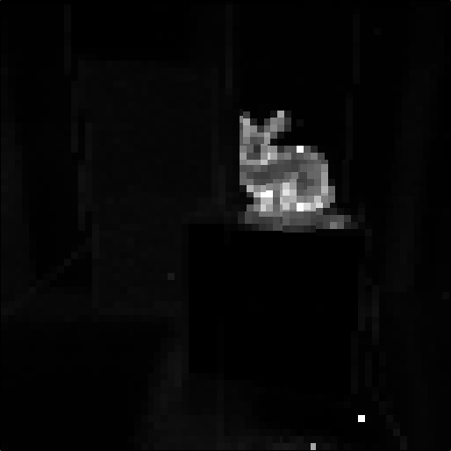
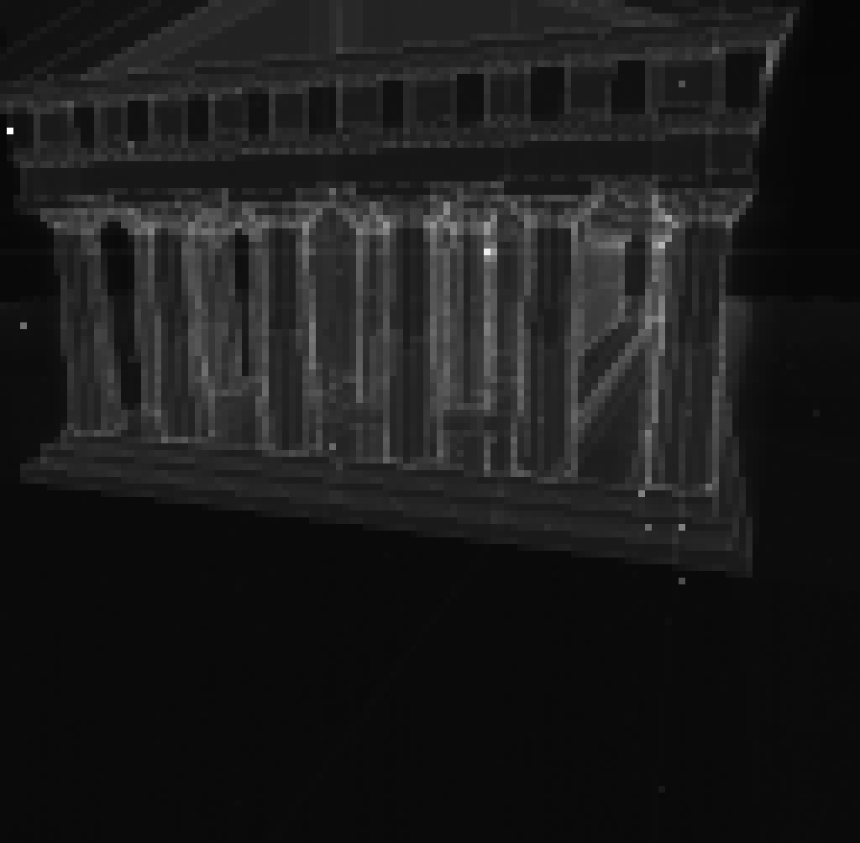
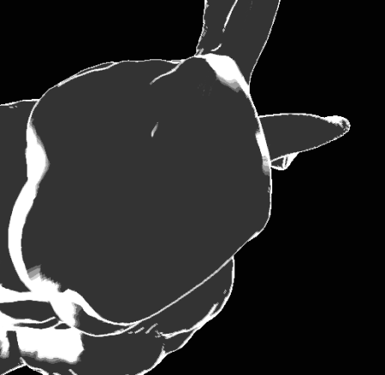
Where do we have expensive areas?
Notes:
Where are expensive areas? Interefelctions (1-2-3) Borders becasue of packet splitting (3-4, and a bit also 2)

Slide 9
Previous work
Ray tracing on distributed memory systems
DSM systems (DeMarle et al. 2005, Ize et al. 2011)
Hybrid CPU/GPU system (Budge et al. 2009)
Massive models (Wald et al. 2004, Dietrich et al. 2007)
Rendering cost evaluation
Profiling (Gillibrand et al. 2006)
Scene geometry decomposition (Reinhard et al. 1998)
Estimate primitive intersections (Mueller et al. 1995)
Notes:
Most important previous work. Of course there are hundreds of papers on ray tracing ect… Remark that our is the first approach combining an image based rendering cost evaluation for parallel ray tracing

Slide 10
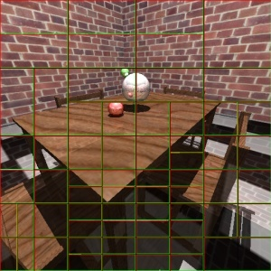
Parallel Ray Tracing
Image-space parallelization
Scenes that cannot be interactively rendered on a single machine
Target hardware
1 Master/visualization node (with GPU)
16 Worker nodes (multi-core CPUs)

Slide 11
Exploiting Parallelism in Ray Tracing
Our approach
Vectorial parallelism
Intel SSE instruction set (ray packets)
Multi-threading parallelism
pthread
Distributed memory parallelism
MPI

Slide 12
Exploiting Parallelism in Ray Tracing
Our approach
Vectorial parallelism
Intel SSE instruction set (ray packets)
Multi-threading parallelism
pthread
Distributed memory parallelism
MPI
critical for performance!
Notes:
Remark where is the more critical part is

Slide 13
Our approach
Compute a per-pixel, image-based estimate of the rendering cost, called cost map
Use the cost map for subdivision and/or scheduling in order to balance the load between workers
A dynamic load balancing scheme improves balancing after the initial tiles assignment

Slide 14
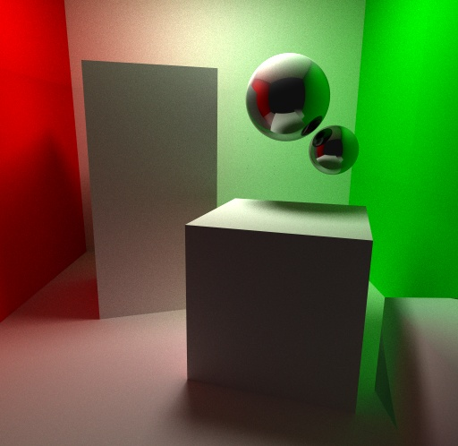
Generate the Cost Map Image-space Sampling
multiple reflections
diffuse
specular
Notes:
-Diffuse surfaces typically have lower cost (in Whitted-style ray tracing), while specular surfaces generate more secondary rays thus causing higher rendering cost.
-Regions where multiple reflections occur are typically more expensive and can be found by a search in image-space.
-When using Monte Carlo-based techniques, the image-space search can be adapted according to the specular coefﬁcient of the surface (see the sphere in the images)

Slide 15
Cost Map Generation Algorithm For each pixel
Add a basic shader cost for the hit surface
If reflective, compute sampling
Compute the sampling pattern
For each sample, do a visibility check by using the reflection cone
If visible, add the cost of the reflected surface
If the hit surfaces is reflective, add a penalty cost
If the reflection cone of the hit surface hit the first one, add a penalty cost
Gather samples contributions
Use a edge detection filter to raise the cost of “border areas”
Ray-packets falling there need to be split and have a higher cost (remarkable only for Whitted)

Slide 16
Sampling Pattern
At ﬁrst, an uniformly distributed set of points is generated (a)
According to the shading properties, the pattern is scaled (b) and translated to the origin (c)
Lastly, it is transformed according to the projection of the reﬂection vector in the image plane (d)

Slide 17
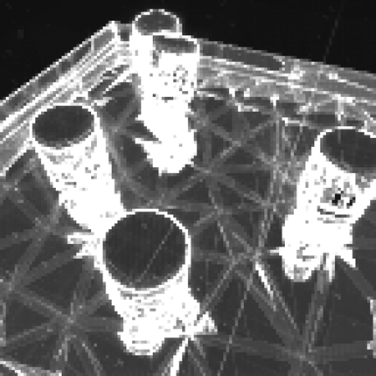
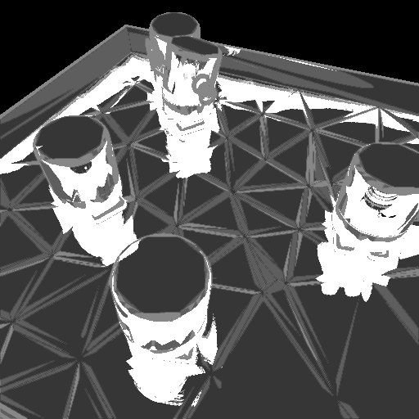
Cost Map Results (1)
A comparison of the real cost (left) and our GPU-based cost estimate (right)

Slide 18
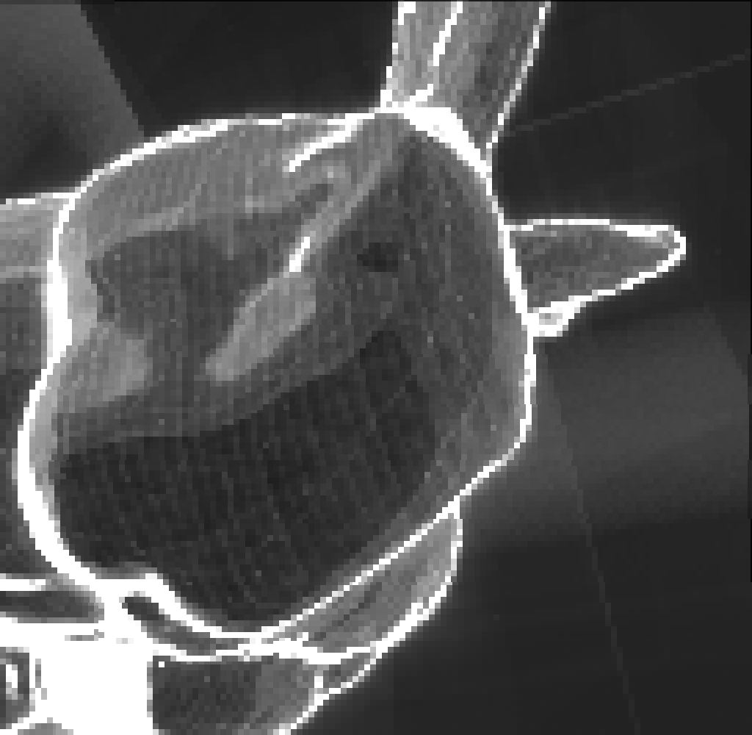
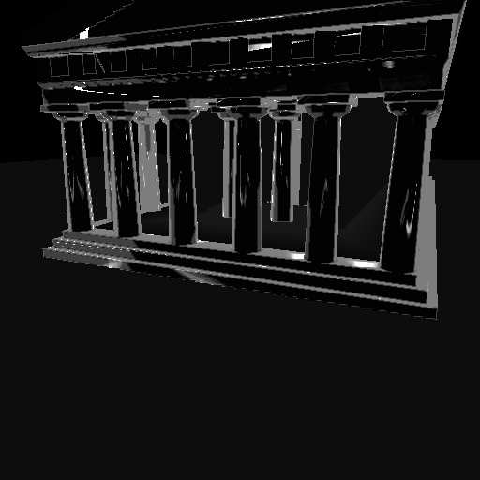
Cost Map Results (2)

Slide 19
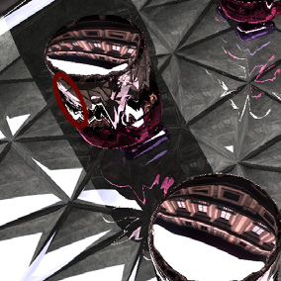
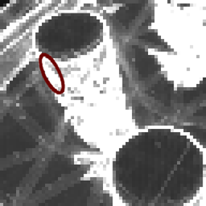
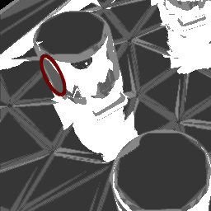
Limitations and Error Analysis
Off-screen geometry problem (under-estimation due to secondary rays falling out of the screen)
Low sampling rate (under-estimation)
Cost estimation error analysis
(+) Cornell scene: 86% of the predictions fall in the first approximation interval (+/−5% of the real packet time)
(-) Ekklesiasterion scene: 57%

Slide 20
Exploiting the Cost Map
Our goal is to improve load balancing
How can we use a cost map estimation for that?
We proposed two approaches
SAT Adaptive Tiling
SAT Sorting

Slide 21
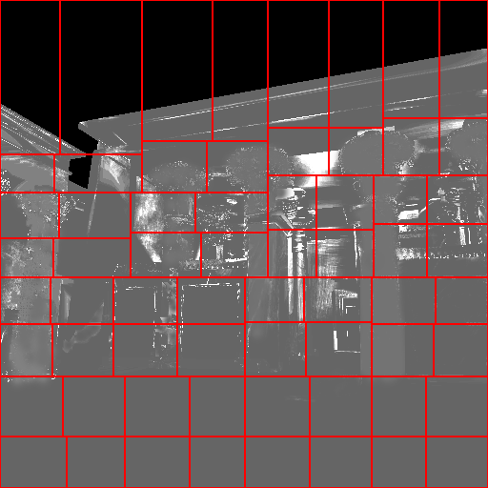
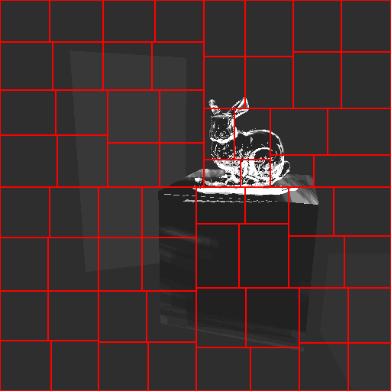
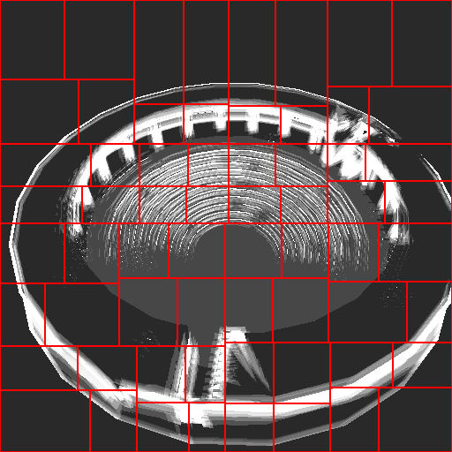
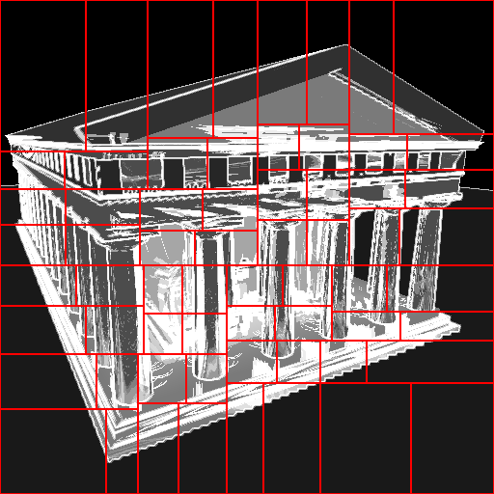
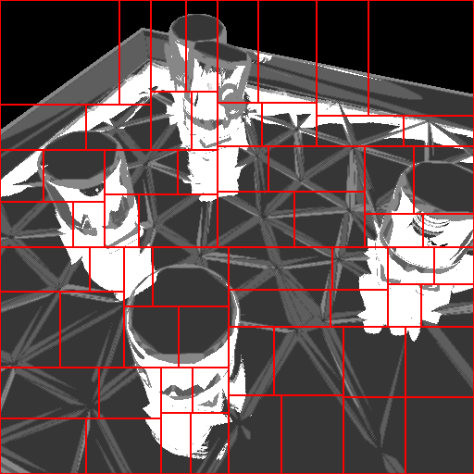
SAT Adaptive Tiling
Adaptive subdivision of the image into tiles of roughly equal cost
Notes:
Remark the meaning of Adaptive Tiling SAT comes in the next slide

Slide 22
SAT Adaptive Tiling
We use a Summed Area Table (SAT) for fast cost evaluation of a tile
SAT allows us to compute the sum of values in a rectangular region of an image in constant time
Details in (Crow & Franklin in SIGGRAPH 84) and (Hensley et al. 2005) for the GPU implementation
SAT Adaptive Tiling
Adaptive subdivision of the image
Weighted kd-tree split using the SAT to locate the optimal splits
Details given in the paper

Slide 23
SAT Sorting
Regular (non adaptive) subdivision
Use SAT to sort tasks (=tiles) by estimate
Improve dynamic load balancing
Schedule more expensive tasks at first
Cheaper tiles later
Dynamic load balancing with work stealing
Ensure fine-grained balancing

Slide 24
Dynamic Load Balancing with Work Stealing
Tile Deque
In-frame steals
Stealing protocol optimizations
Task prefetching
master
tile assignment
workers
work stealing
Notes:
Quick here, just an overview

Slide 25
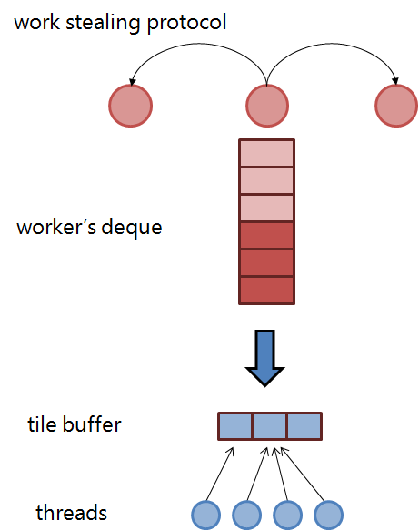
Ray Packet and Tile
Two task definitions
Tile for distributed node
Packet for single node ray tracer
Tile Buffer
Threads work on more tiles
Improved multi threading scalability

Slide 26
Results Performance with different techniques
Notes:
Parameters and performance comparison for our five test scenes; timings are given in seconds per frame. We report speedup and also efficiency which describes the fraction of the time that is being used by the processors. Tests have been performed with 16 workers and multi-threading. (*) Speedup and efficiency is shown for Regular without WS and SAT Sorting approach.

Slide 27
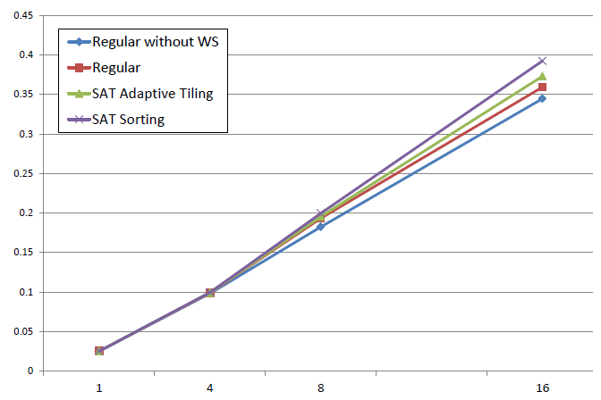
Results Scalability
Scalability for up to 16 workers measured for the Cornell Box and path tracing. Timings are in fps.

Slide 28
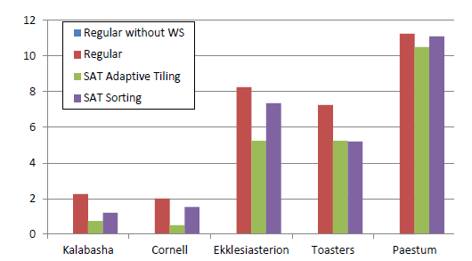
Results Work steal (tile transfers)
Lower number of tile transfers for adaptive tiling
The initial tile assignment provided by the adaptive tiling is more balanced than the regular one
Work stealing does not work well with such kind of (almost balanced) workload
Average number of tile transfers performed during our test with 4 workers

Slide 29
Comments
SAT Adaptive Tiling
Needs a very accurate cost map estimate to have an improvement in performance
“How much a tile is more expensive than another one?”
Does not fit well with dynamic load balancing
SAT Sorting
It works also with a less accurate Cost Map
“Which ones are the more expensive tiles?”
Well fit with the work stealing algorithm
Best performance

Slide 30
Conclusion
Cost map
A per-pixel, image-based estimate of the rendering cost
Cost map exploitation for parallel ray tracing
Two strategies
Cost map generation and exploitation as two decoupled phases
We can mix them with other approaches

Slide 31
Thanks for your attention
Paper’s web page http://www.dps.uibk.ac.at/~cosenza/papers/CostMap
Acknowledgements FWF, BMWF, DAAD, HPC-Europa2 Intel Visual Computing Institute

Slide 32
Backup slides

Slide 33
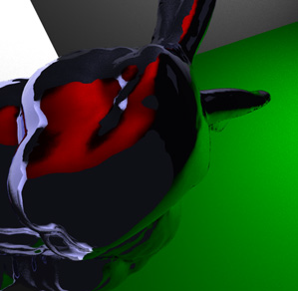
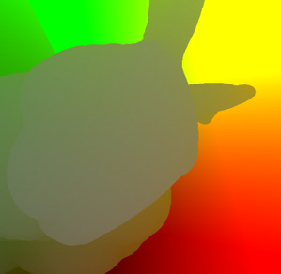
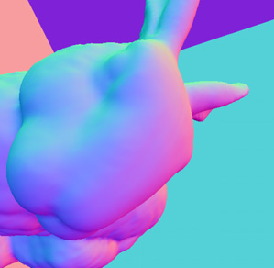
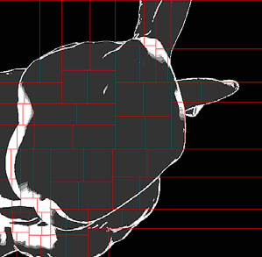
Cost Map Generation Algorithm
Sampling pattern
Wider sampling pattern for Lambertian and glossy surfaces for path tracing
The pattern collapses to a line for Whitted-style ray tracing and for path tracing using a perfect mirror material.
Sample gathering
By summing up the sample contributions, in path tracing
We suppose that secondary rays spread along a wide area
By taking their maximum, with Whitted ray tracing
All samples belong to one secondary ray and we conservatively estimate the cost by taking the maximum.
Edge detection
Ray-packet splitting raises the cost because of the loss of coherence between rays, and this happens especially in “geometric edges”
We experienced that this extra cost is significant only with Whitted ray tracing
Implementation uses deferred shading, with a 2nd sampling pass

Slide 34
Cost Map Generation Algorithm
Code for pixel Pi
//All the data of the hit surface on the pixel Pi are available
cost_{i} ← basic material cost of the hit surface;
if P_{i} is reflective then
//Determinate the sampling pattern S, at the point P_{i}, toward the reflection vector R
S = compute_sampling_pattern(P_{i},R);
// For each samples, calculate cost contribute
for each sample S j in S do
sample j ← 0;
if visibility_check(S_{j},P_{i}) then
increase samplej;
if secondary reflection check(S_{j},P_{i}) then
increase sample_{j};
end
end
end
//Samples gathering
cost_{i} = cost_{i} + gather(S);
end
return cost_{i;}

Slide 35
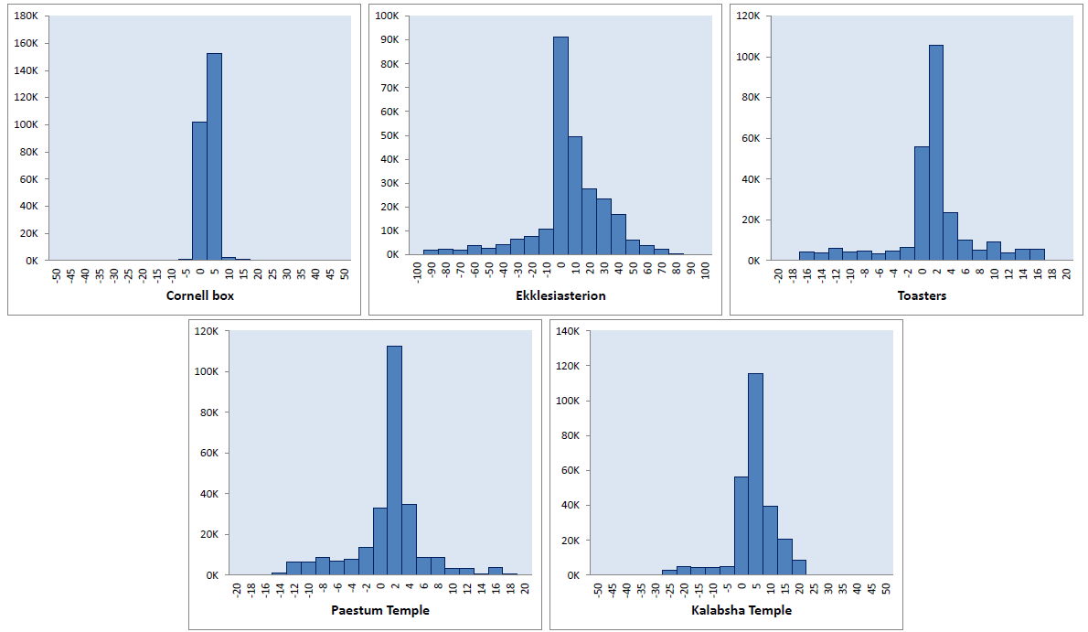
Error Analysis
Error distribution of the estimation. Each packet-based rendering time is subtract from the cost map estimate, for the same corresponding packet of pixels. The x-axis shows the difference in error intervals, from negative values (left, over-estimation) to positive ones (right, under-estimation). The y-axis plots error occurrences for each error interval.

